Slide 1

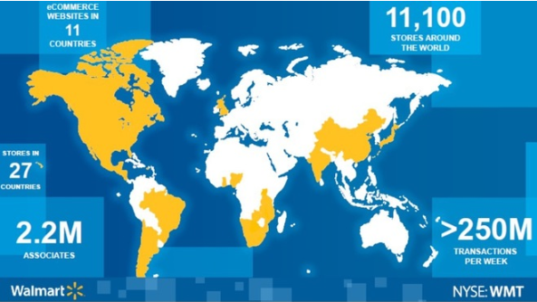
Data analysis in Retails:
A Multi-Dimensional Analysis of Walmart's Sales Ecosystem Using Advanced MYSQL Techniques
Name:- Anirudh Shambharkar
Batch:- 15th April 2025
Course:- Data Science PGC

Slide 2
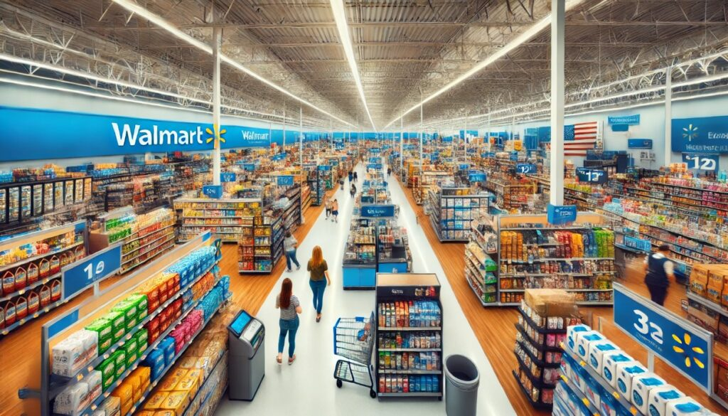
Introduction:- Walmart, a global retail leader, generates vast amounts of transactional data across its branches. This project analyzes comprehensive sales data encompassing customer demographics, product categories, and payment methods to derive actionable insights. By leveraging advanced mysql queries and data analytics techniques, we explore patterns in customer behavior, sales performance, and product trends to support data-driven decision-making for business optimization.
PROBLEM STATEMENT:-
Walmart aims to enhance its sales strategies by analyzing historical transaction data across multiple dimensions of its retail operations. The challenge is to extract meaningful insights from complex sales data to optimize inventory management, improve customer satisfaction, and maximize revenue. This project addresses this challenge through detailed analysis of sales patterns, customer segmentation, payment preferences, and product performance across different branches.

Slide 3



DATASET OVERVIEW
DATA SOURCE : Walmart Sales Data provided by course instructor for analytical purpose
SIZE OF DATA : Contains 1000 rows and 13 columns.
TIME FRAME : Contains data of 3 months from Jan 2019 to Mar 2019.
KEY COLUMNS :
Branch : Identifies the Walmart branch (A,B,C).
City : Location of the branch.
Date : Transaction date in DD-MM-YYYY format.
Gender : Male or female customers.
Product line : Categories of the product sold.
Unit price : Price per unit of product.
Quantity : Number of units purchased in a transaction.
Total : Total transaction value.
COGS : Cost incurred by the Walmart for the goods sold.
Gross income : Profit margin for each transaction.
Payment method : Payment mode used for the transaction.

Slide 4
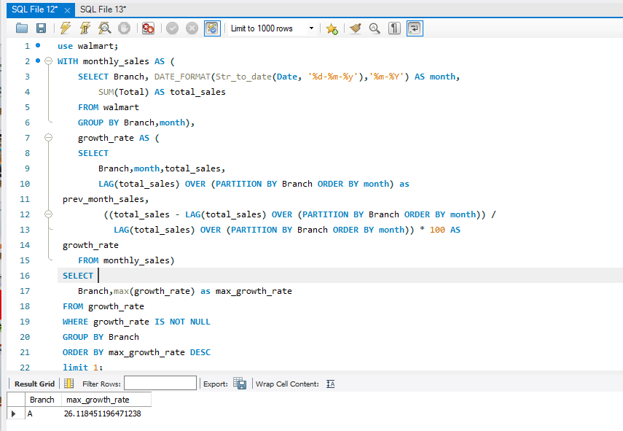
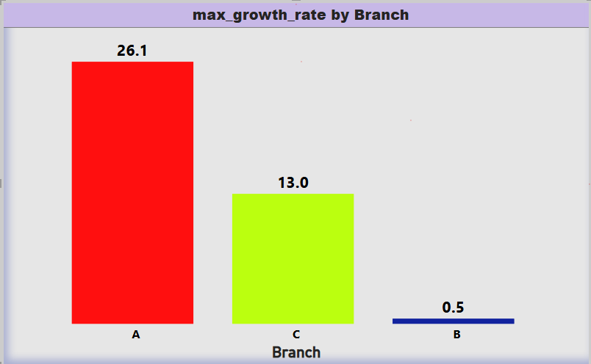
Task.1 :- Identifying the Top Branch by Sales Growth Rate
Branch ‘A’ has the maximum growth rate at 26.11 as compare to the other branches among all branches of Walmart.

Slide 5
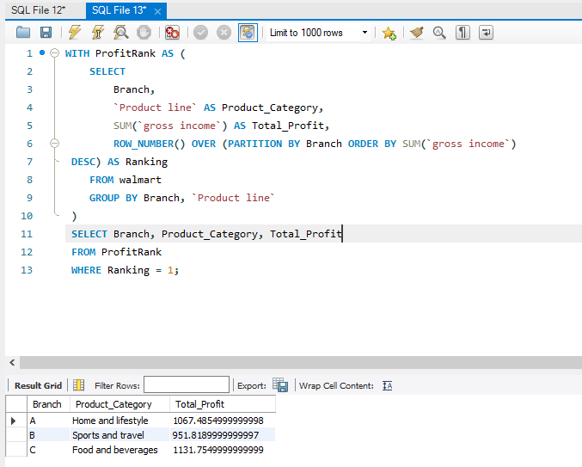
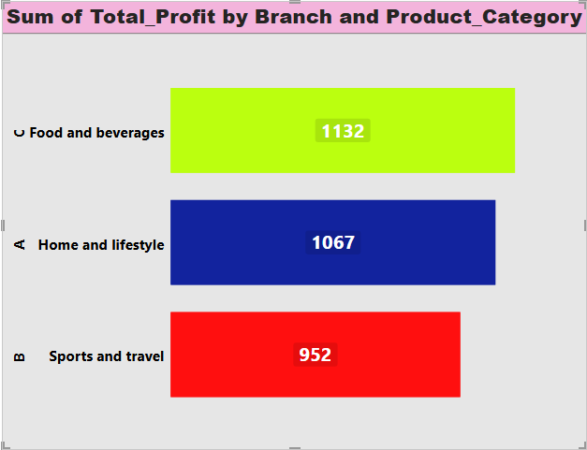
Task.2 :- Finding The Most Profitable Product Line For Each Branch
Home and lifestyle is the most profitable product line for branch ‘A’, similarly sports & travel is for branch ‘B’ and food & beverages is for branch ‘C’, giving a total profit of 1067.4,951.8,1131.8 respectively.

Slide 6
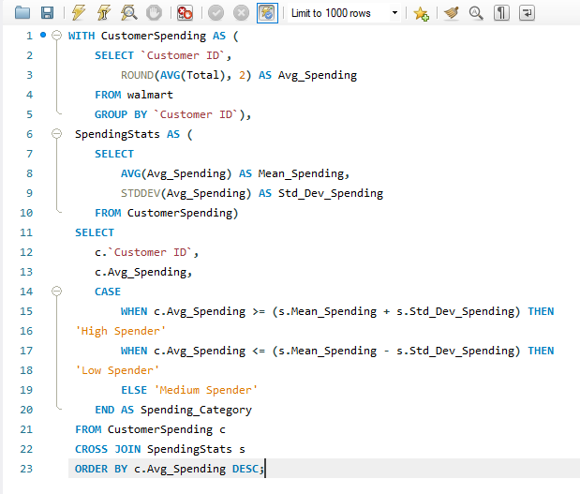
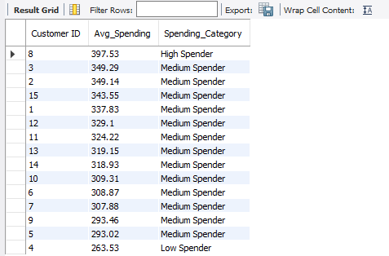
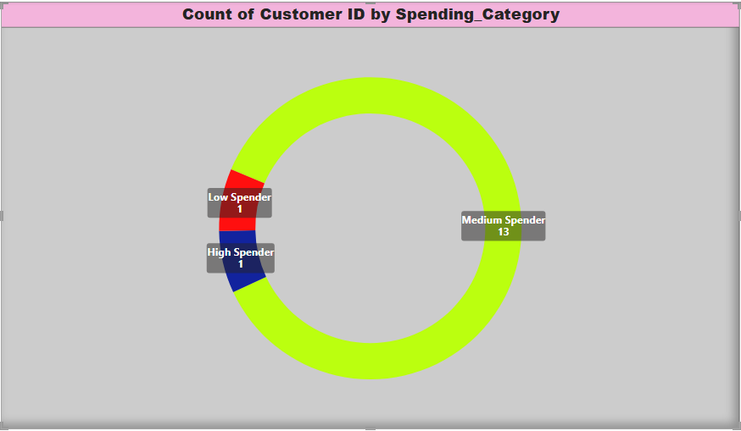
Task.3 :- Analyzing Customer Segmentation Based On Spending
From A Total Of 15 Customers 13 Customers Falls Under Medium Spender Category And One Each In ‘High’ And ‘Low’ Spender Category

Slide 7
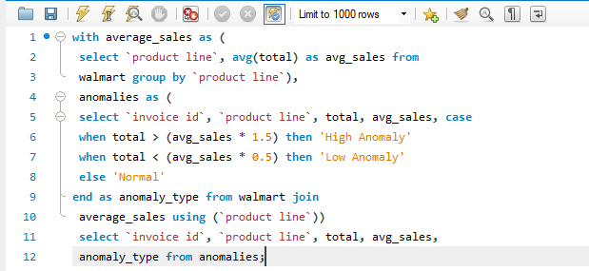
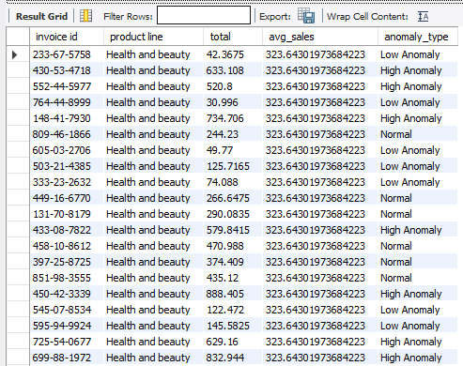
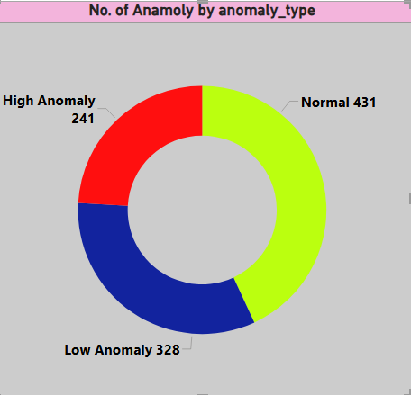
Task. 4 :-Detecting Anomalies In Sales Transactions
From A Total Of 1000 Records Present In The Dataset, 241 Are Of High Anomaly, 328 Are Of Low Anomaly, 431 Are Normal.

Slide 8
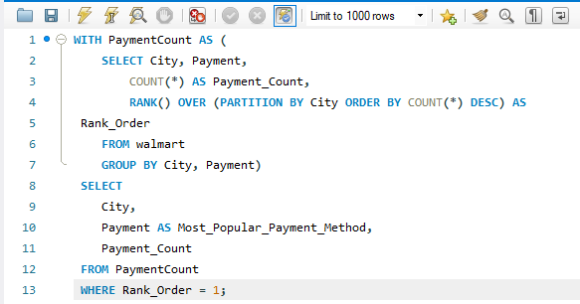
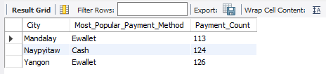
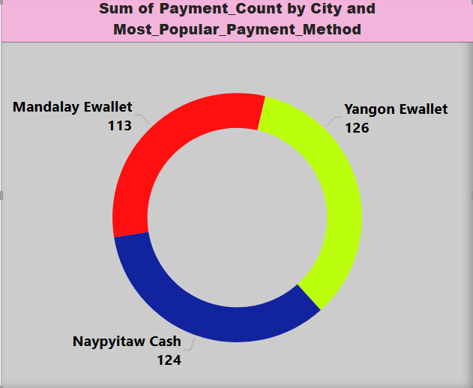
Task. 5 :- Most Popular Payment Method By City
E-wallet, Cash and E-wallet is the most popular payment method ith the cities Mandalay, Naypyitaw and Yangon respectively havitng total payment count as 113,124 and 126 respectively.

Slide 9
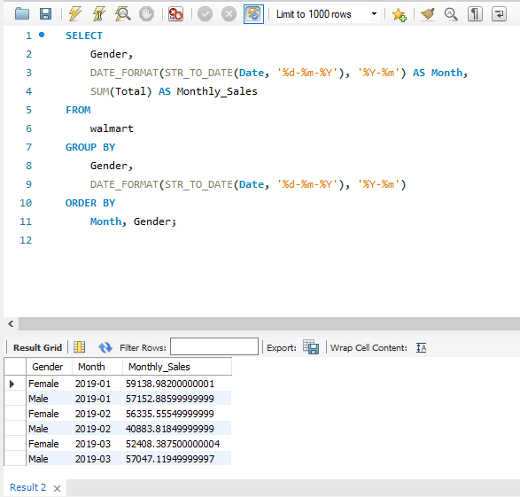
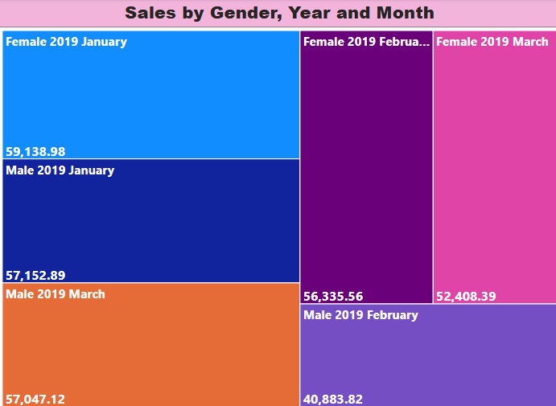
Task. 6 :- Monthly Sales Distribution By Gender
Females In The Month Of January Have Made Highest Amount Of Purchase At 59138.98 And Similarly, Males In The Month Of February Have Made Lowest Amount Of Purchase At 40883.81.

Slide 10
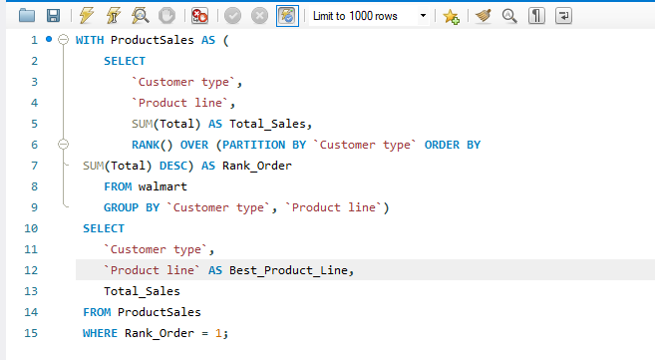
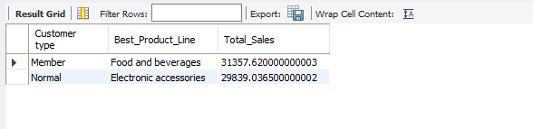
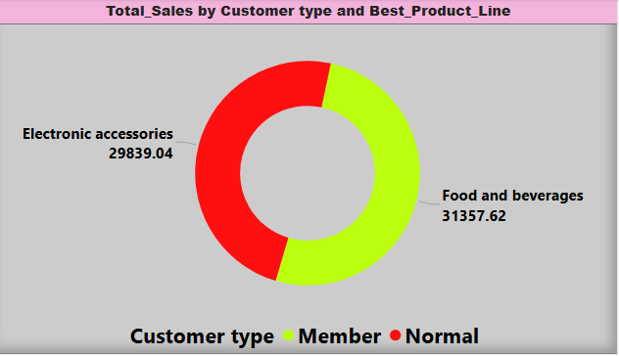
Task. 7 :- Best Product Line By Customer Type
Food & beverages and Electronics accessories is the best product line for the customer type Member and Normal respectively, generating a total sales of 31357.62 and 29839.04 respectively.

Slide 11
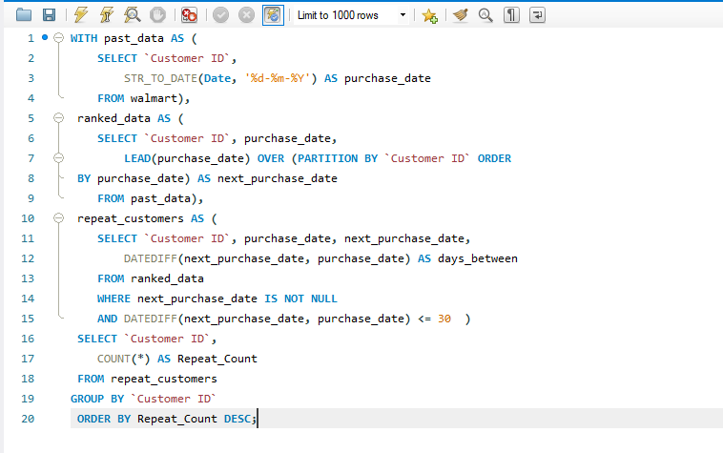
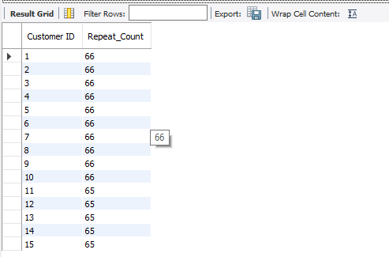
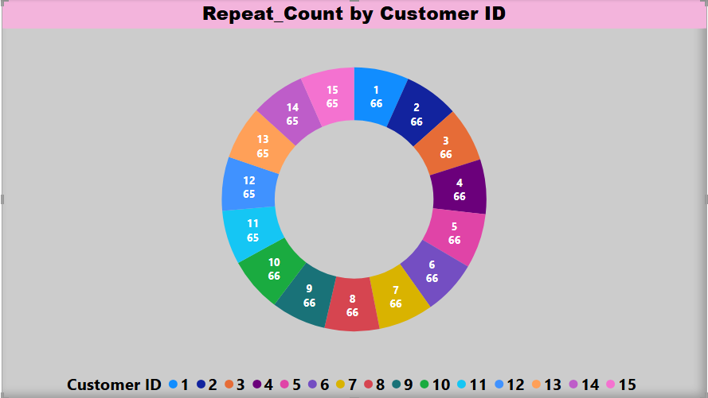
Task. 8 :- Identify Repeat Customers
Among the all 15 customer IDs, 10 of them have the repeat count of 66 where as 5 of them have the repeat count of 65

Slide 12
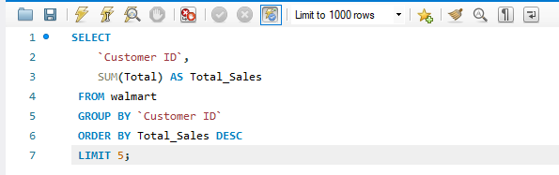
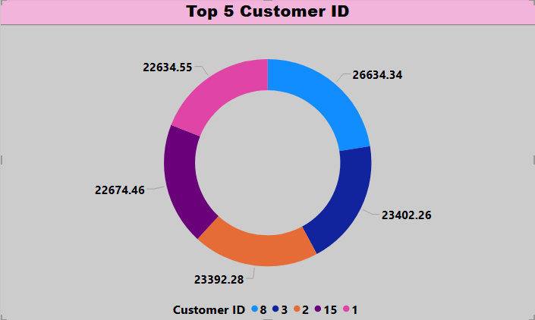
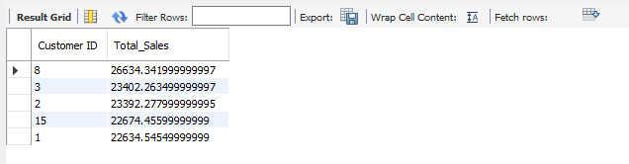
Task. 9 :- Identify Top 5 Customers by Sales Volume
AMONG THE TOP 5 CUSTOMERS BY SALES VOLUME, CUTOMER_ID - 8 HAS THE HIGHEST SALES VOLUME AT 26634.34 AND THEN ID - 3, 2, 15 AND 1 ARE AT THE 2ND, 3RD, 4TH AND 5TH POSITION RESPECTIVELY BY SALES VOLUME

Slide 13
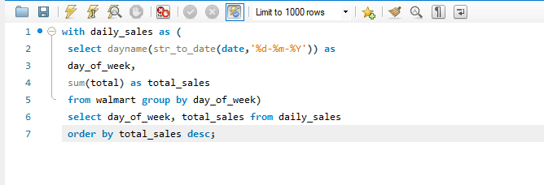
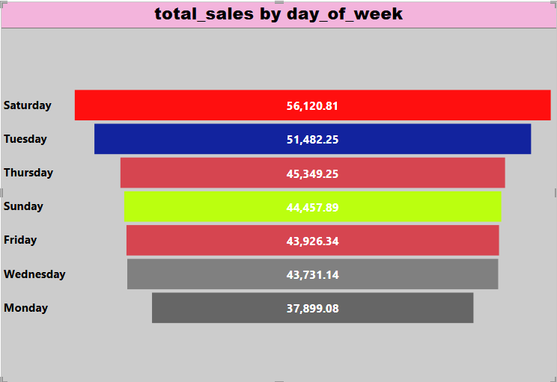
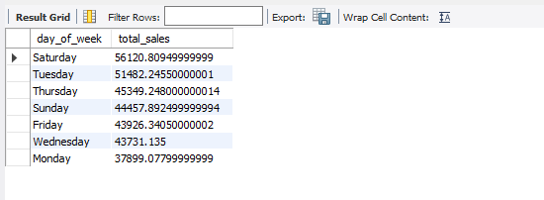
Task. 10 :- Analyzing Sales Trends By Day Of The Week
Saturday shows peak sales at 56,120 while Monday has lowest at 37,899 indicating weekend shopping preference among customers

Slide 14
Conclusion
🛒 Walmart sales analysis – key insights
📈 Top branch identified highest growth in sales pinpointed to a specific branch, guiding regional investment.
💡 Most profitable product lines clear leaders in product categories driving overall revenue.
👥 Customer segmentation by spending Spending patterns helped classify customers for targeted marketing.
⚠️ Sales anomalies detected irregularities in data highlighted potential operational or recording issues.
🏙️ Popular payment methods by city preferences varied by location, useful for city-level strategy.
📊 Monthly sales trends by gender distinct trends observed, aiding gender-targeted promotions.
🔁 Repeat customers tracked insights into customer loyalty and retention potential.
💰 Top 5 highest-spending customers identified valuable customers for personalized offers.
📅 Sales trends by day of week weekday patterns can guide staffing and promotion timing.

Slide 15
Video Explanation link
https://drive.google.com/file/d/1cJsmsbDqXGqIqLSAEfcsOSBdiLb9icT2/view?usp=sharing

Slide 16


